Slide 1
Optimum Portfolio Allocation Based on ETFs using Modern Portfolio Theory
Presented by Dahirou Ndiaye
Master of Science in Statistics
Sponsored by Dr. Raj Chhikara

Slide 2
Introduction
In a survey of investment professionals, conducted in March 2008, 67% called ETFs the most innovative investment vehicle of the last two decades and 60% reported that ETFs have fundamentally changed the way they construct investment portfolios (Knowledge at Wharton, 2008).
This paper addresses optimum allocation based on some selected ETFs. The selection of assets or equities is not just a problem of finding attractive investments. Designing the correct portfolio of assets cannot be done by human intuition alone and requires modern, powerful and reliable mathematical programs called optimizers. Any investor would like to have the highest return possible from an investment. However, this has to be counterbalanced by the amount of risk the investor is able or desires to take.

Slide 3
Introduction
The mathematical problem of portfolio optimization was initiated by Professor Harry Markowitz in the fifties and he was rewarded with a Nobel Prize in Economics in 1990 which he shared with Professors William Sharpe and Merton Miller.
Portfolio optimization is often called mean-variance (MV) optimization. The term mean refers to the mean or the expected return of the investment and the variance is the measure of the risk associated with the portfolio. The mathematical problem can be formulated in many ways but the principal problem that this paper is about is to minimize risk for a speciﬁed expected return.
The above problem could have linear or nonlinear constraints, equality and inequality constraints.

Slide 4
Definitions
A portfolio is a collection of investments held by an institution or an individual. The assets in the portfolio could include bank accounts, stocks, bonds, options, warrants, gold certificates, real estate, futures contracts, production facilities, or any other item that is expected to retain its value.
Modern portfolio theory (MPT) is a theory of investment which attempts to maximize portfolio expected return for a given amount of portfolio risk, or equivalently minimize risk for a given level of expected return, by carefully choosing the proportions of various assets. It is indeed a mathematical formulation of the concept of diversification in investing, with the aim of selecting a collection of investment assets that has collectively lower risk than any individual asset.

Slide 5
Definitions
An exchange-traded fund (ETF) is an investment fund traded on stock exchanges, much like stocks. An ETF holds assets such as stocks, commodities, or bonds and trades at approximately the same price as the net asset value of its underlying assets over the course of the trading day. ETFs are the most popular type of exchange-traded product.
Standard deviation is a representation of the risk associated with a given security (stocks, bonds, property, etc.), or the risk of a portfolio of securities (actively managed mutual funds, index mutual funds, or ETFs).
Risk is an important factor in determining how to efficiently manage a portfolio of investments because it determines the variation in returns on the asset and/or portfolio and gives investors a mathematical basis for investment decisions (known as mean-variance optimization).

Slide 6
Objective
The objective of this study is to build and allocate a diversified portfolio with the goal of minimizing its risk and maximizing its expected return. We use the Markowitz model which is an optimal model for balancing the return and risk portfolio. The model minimizes the variance of the portfolio’s total return, subject to the constraints:
the expected growth of the portfolio reaches some target level .
you do not invest more capital than you have.

Slide 7
Data
This study analyzed ETF strategies available from a public source “Yahoo Finance”. The timeline vary from Feb 2005 to Jan 2011. The periods are Daily (1492 days), Weekly (309 weeks) and Monthly (76 months).

Slide 8
Structure and Types of ETFs
As of August 2010, available ETFs could be broken up into the following categories and some subcategories:
Domestic Equity- Large Caps, Mid Caps, Small Caps.
Sectors - Energy, Health Care, Financials, Telecom., Materials, Industrials, Information Technologies.
International-Emerging Markets, Europe, Asia, Americas, Global.
Commodities - Gold, Metals, US Oil Fund, etc..
Bonds - Short Term Corporate, Intermediate Term Corporate, Long Term Corporate, Investment Grade, High Yield, US Government, International.
Currency
Real Estate

Slide 9
Variables
Open: The start of trading on a security exchange.
High/Low: The highest and lowest price at which a stock has traded during its date
Close: The end of a trading session
Volume: The number of shares or contracts traded in a security or an entire market during a given period of time.
Adj Close: A stock's closing price on any given day of trading that has been amended to include any distributions and corporate actions that occurred at any time prior to the next day's open. It is often used when examining historical returns or performing a detailed analysis on historical returns.
Rate of Returns (ROR): The rate of return, also known as return on investment (ROI), rate of profit, is the ratio of money gained or lost (whether realized or unrealized) on an investment relative to the amount of money invested.

Slide 10
Selection of ETFs
Table I.I below shows few ETFs that were used for analysis. We selected 14 ETFs among 30 downloaded because we eliminated several that could not support a 6-year price or performance history. Their prices were collected (Daily, Weekly, Monthly) from February 2005 to January 2011.

Slide 11
Table I.I Selected ETFs
Symbol | Name | Description
IYY | iShares Dow Jones U.S. Index | U.S. equity broad market
SPY | SPDRs | Weighted index of 500 common stock prices in US companies.
EFA | iShares MSCI EAFE Index | Securities in the European, Australasian and Far Eastern markets
IAU | iShares COMEX Gold Trust | Price of gold bullion
EEM | iShares MSCI Emerging Markets Index | Equity market performance in the global emerging markets
AGG | iShares Barclays Aggregate Bond | United States investment grade bond market
IJH | iShares S&P MidCap 400 Index | U.S. mid-cap stocks
IJR | iShares S&P SmallCap 600 Index | U.S. small-cap stocks
XLE | Energy Select Sector SPDR | Energy
EWZ | iShares MSCI Brazil Index | Exchange traded-fund of Brazilian stocks.
EWH | iShares MSCI Hong Kong Index | Exchange traded-fund of Hong Kong stocks.
EZU | iShares MSCI EMU Index | traded securities in the European Monetary Union
EWJ | iShares MSCI Japan Index Fund | Exchange traded-fund of Japanese stocks
IYR | iShares Dow Jones US Real Estate | US Real Estate

Slide 12

Rate of Return
Calculation of single-period rate of return
The arithmetic return is:
r_{arim} =100*
Where V_{i and} V_{f} are the initial and final values of an investment.

Slide 13
Graphical Description Case study example
“iShares Barclays Aggregate Bond (AGG)”
Rate of Return
Volume
Rate of Return vs. Volume

Slide 14
Descriptive Statistics of the Rate of Return (AGG)

Slide 15
Descriptive Statistics of Volume (AGG)

Slide 16
Scatter Plots of the Rate of Return vs. Volume
The returns are mainly concentrated over the range of -1 and 1 with few returns reaching up to -2 and 2. Both positive and negative returns are almost evenly spread. However, we do observe two outliers.

Slide 17
Data Analysis Correlation Structure
Why correlation coefficient is important?
An investor can reduce portfolio risk simply by holding instruments which are not perfectly correlated. In other words, investors can reduce their exposure to individual asset risk by holding a diversified portfolio of assets.
Diversification will allow for the same portfolio return with reduced risk. If all the assets of a portfolio have a correlation of 1, i.e., perfect correlation, the portfolio volatility (standard deviation) will be equal to the weighted sum of the individual asset volatilities.
If all the assets have a correlation of 0, i.e., perfectly uncorrelated, the portfolio variance is the sum of the individual asset weights squared times the individual asset variance (and volatility is the square root of this sum).
If correlation is less than zero, i.e., the assets are inversely correlated, the portfolio variance and hence volatility will be less than if the correlation is 0.

Slide 18
Daily Return Correlation Table
 | SPY | IJH | IJR | IYY | XLE | EWZ | EWJ | EWH | EEM | EZU | EFA | AGG | IAU | IYR
SPY | 1 | -0.09 | -0.06 | -0.10 | -0.14 | -0.07 | -0.09 | -0.07 | -0.04 | -0.08 | -0.09 | -0.12 | -0.09 | -0.05
IJH | 0.95 | 1.00 | 0.96 | 0.97 | 0.79 | 0.80 | 0.76 | 0.79 | 0.86 | 0.85 | 0.87 | -0.09 | 0.10 | 0.85
IJR | 0.91 | 0.96 | 1.00 | 0.93 | 0.72 | 0.74 | 0.71 | 0.75 | 0.81 | 0.80 | 0.82 | -0.15 | 0.06 | 0.84
IYY | 0.98 | 0.97 | 0.93 | 1.00 | 0.80 | 0.81 | 0.78 | 0.82 | 0.89 | 0.89 | 0.91 | -0.09 | 0.08 | 0.84
XLE | 0.81 | 0.79 | 0.72 | 0.80 | 1.00 | 0.80 | 0.68 | 0.71 | 0.80 | 0.77 | 0.80 | -0.03 | 0.26 | 0.58
EWZ | 0.82 | 0.80 | 0.74 | 0.81 | 0.80 | 1.00 | 0.72 | 0.77 | 0.90 | 0.80 | 0.83 | -0.01 | 0.23 | 0.61
EWJ | 0.80 | 0.76 | 0.71 | 0.78 | 0.68 | 0.72 | 1.00 | 0.76 | 0.80 | 0.79 | 0.87 | 0.04 | 0.15 | 0.61
EWH | 0.83 | 0.79 | 0.75 | 0.82 | 0.71 | 0.77 | 0.76 | 1.00 | 0.89 | 0.78 | 0.83 | -0.10 | 0.10 | 0.68
EEM | 0.89 | 0.86 | 0.81 | 0.89 | 0.80 | 0.90 | 0.80 | 0.89 | 1.00 | 0.87 | 0.90 | -0.08 | 0.19 | 0.71
EZU | 0.89 | 0.85 | 0.80 | 0.89 | 0.77 | 0.80 | 0.79 | 0.78 | 0.87 | 1.00 | 0.97 | -0.02 | 0.20 | 0.72
EFA | 0.92 | 0.87 | 0.82 | 0.91 | 0.80 | 0.83 | 0.87 | 0.83 | 0.90 | 0.97 | 1.00 | 0.00 | 0.20 | 0.72
AGG | -0.05 | -0.09 | -0.15 | -0.09 | -0.03 | -0.01 | 0.04 | -0.10 | -0.08 | -0.02 | 0.00 | 1.00 | 0.09 | -0.14
IAU | 0.07 | 0.10 | 0.06 | 0.08 | 0.26 | 0.23 | 0.15 | 0.10 | 0.19 | 0.20 | 0.20 | 0.09 | 1.00 | 0.02
IYR | 0.81 | 0.85 | 0.84 | 0.84 | 0.58 | 0.61 | 0.61 | 0.68 | 0.71 | 0.72 | 0.72 | -0.14 | 0.02 | 1.00
From the daily return correlation table of the 14 ETF’s, we observe that the rate of return of Gold (IAU), the Aggregate Bond (AGG) and weighted index of 500 common stock prices in US companies (SPY) share low or no correlation with the equity, international and real estate ETF’s which rate of returns, in turn, show strong correlations among themselves.

Slide 19
Weekly Return Correlation Table
 | SPY | IJH | IJR | IYY | XLE | EWZ | EWJ | EWH | EEM | EZU | EFA | AGG | IAU | IYR
SPY | 1.00 | 0.95 | 0.92 | 0.99 | 0.79 | 0.80 | 0.75 | 0.77 | 0.85 | 0.88 | 0.90 | 0.25 | 0.01 | 0.79
IJH | 0.95 | 1.00 | 0.97 | 0.97 | 0.79 | 0.81 | 0.70 | 0.73 | 0.86 | 0.85 | 0.87 | 0.14 | 0.07 | 0.84
IJR | 0.92 | 0.97 | 1.00 | 0.94 | 0.73 | 0.75 | 0.67 | 0.71 | 0.83 | 0.82 | 0.83 | 0.09 | 0.05 | 0.85
IYY | 0.99 | 0.97 | 0.94 | 1.00 | 0.78 | 0.79 | 0.73 | 0.75 | 0.85 | 0.87 | 0.89 | 0.19 | 0.02 | 0.81
XLE | 0.79 | 0.79 | 0.73 | 0.78 | 1.00 | 0.81 | 0.67 | 0.63 | 0.79 | 0.77 | 0.80 | 0.21 | 0.30 | 0.54
EWZ | 0.80 | 0.81 | 0.75 | 0.79 | 0.81 | 1.00 | 0.69 | 0.74 | 0.91 | 0.81 | 0.85 | 0.16 | 0.25 | 0.60
EWJ | 0.75 | 0.70 | 0.67 | 0.73 | 0.67 | 0.69 | 1.00 | 0.70 | 0.75 | 0.76 | 0.85 | 0.28 | 0.11 | 0.53
EWH | 0.77 | 0.73 | 0.71 | 0.75 | 0.63 | 0.74 | 0.70 | 1.00 | 0.81 | 0.76 | 0.80 | 0.15 | 0.12 | 0.62
EEM | 0.85 | 0.86 | 0.83 | 0.85 | 0.79 | 0.91 | 0.75 | 0.81 | 1.00 | 0.87 | 0.90 | 0.12 | 0.21 | 0.69
EZU | 0.88 | 0.85 | 0.82 | 0.87 | 0.77 | 0.81 | 0.76 | 0.76 | 0.87 | 1.00 | 0.97 | 0.20 | 0.18 | 0.69
EFA | 0.90 | 0.87 | 0.83 | 0.89 | 0.80 | 0.85 | 0.85 | 0.80 | 0.90 | 0.97 | 1.00 | 0.25 | 0.19 | 0.69
AGG | 0.25 | 0.14 | 0.09 | 0.19 | 0.21 | 0.16 | 0.28 | 0.15 | 0.12 | 0.20 | 0.25 | 1.00 | -0.06 | 0.02
IAU | 0.01 | 0.07 | 0.05 | 0.02 | 0.30 | 0.25 | 0.11 | 0.12 | 0.21 | 0.18 | 0.19 | -0.06 | 1.00 | 0.03
IYR | 0.79 | 0.84 | 0.85 | 0.81 | 0.54 | 0.60 | 0.53 | 0.62 | 0.69 | 0.69 | 0.69 | 0.02 | 0.03 | 1.00

Slide 20
Monthly Return Correlation Table
 | SPY | IJH | IJR | IYY | XLE | EWZ | EWJ | EWH | EEM | EZU | EFA | AGG | IAU | IYR
SPY | 1.00 | 0.95 | 0.92 | 1.00 | 0.68 | 0.73 | 0.75 | 0.76 | 0.85 | 0.90 | 0.91 | 0.14 | 0.06 | 0.81
IJH | 0.95 | 1.00 | 0.97 | 0.97 | 0.69 | 0.73 | 0.75 | 0.72 | 0.84 | 0.84 | 0.86 | 0.11 | 0.07 | 0.83
IJR | 0.92 | 0.97 | 1.00 | 0.94 | 0.62 | 0.64 | 0.71 | 0.65 | 0.78 | 0.80 | 0.81 | 0.07 | -0.01 | 0.86
IYY | 1.00 | 0.97 | 0.94 | 1.00 | 0.68 | 0.74 | 0.76 | 0.76 | 0.86 | 0.90 | 0.91 | 0.14 | 0.06 | 0.82
XLE | 0.68 | 0.69 | 0.62 | 0.68 | 1.00 | 0.78 | 0.57 | 0.62 | 0.75 | 0.64 | 0.68 | -0.06 | 0.28 | 0.43
EWZ | 0.73 | 0.73 | 0.64 | 0.74 | 0.78 | 1.00 | 0.66 | 0.82 | 0.91 | 0.75 | 0.79 | 0.10 | 0.36 | 0.52
EWJ | 0.75 | 0.75 | 0.71 | 0.76 | 0.57 | 0.66 | 1.00 | 0.64 | 0.77 | 0.80 | 0.87 | 0.28 | 0.18 | 0.65
EWH | 0.76 | 0.72 | 0.65 | 0.76 | 0.62 | 0.82 | 0.64 | 1.00 | 0.88 | 0.78 | 0.82 | 0.22 | 0.28 | 0.58
EEM | 0.85 | 0.84 | 0.78 | 0.86 | 0.75 | 0.91 | 0.77 | 0.88 | 1.00 | 0.88 | 0.91 | 0.19 | 0.29 | 0.67
EZU | 0.90 | 0.84 | 0.80 | 0.90 | 0.64 | 0.75 | 0.80 | 0.78 | 0.88 | 1.00 | 0.98 | 0.29 | 0.14 | 0.75
EFA | 0.91 | 0.86 | 0.81 | 0.91 | 0.68 | 0.79 | 0.87 | 0.82 | 0.91 | 0.98 | 1.00 | 0.26 | 0.18 | 0.74
AGG | 0.14 | 0.11 | 0.07 | 0.14 | -0.06 | 0.10 | 0.28 | 0.22 | 0.19 | 0.29 | 0.26 | 1.00 | 0.32 | 0.25
IAU | 0.06 | 0.07 | -0.01 | 0.06 | 0.28 | 0.36 | 0.18 | 0.28 | 0.29 | 0.14 | 0.18 | 0.32 | 1.00 | 0.07
IYR | 0.81 | 0.83 | 0.86 | 0.82 | 0.43 | 0.52 | 0.65 | 0.58 | 0.67 | 0.75 | 0.74 | 0.25 | 0.07 | 1.00
Weekly and monthly rate return correlation tables indicate less correlation between Gold(IAU) and Bond (AGG).
The others ETFs show strong correlations among themselves.

Slide 21
Portfolio Construction Navigate the Road Ahead
Investors need a financial plan to guide their investments journey. First consider your goals, and then decide what investing vehicles will help you reach each milestone leading up to your goal.
The best mix of investments for your portfolio depends on your risk tolerance, your time horizon and your particular goals. Many investors save for several financial objectives at the same time.

Slide 22
Portfolio Construction Diversification
Diversification cushions you to a certain degree from the ups and downs of various market segments. Studies show that investors with a diversified portfolio of stocks and bonds – or of funds invested in stocks and bonds – maximize their investing returns. A diversified portfolio experiences less volatility than a concentrated portfolio. Each person must decide how the various pieces of the asset allocation puzzle fit together.

Slide 23
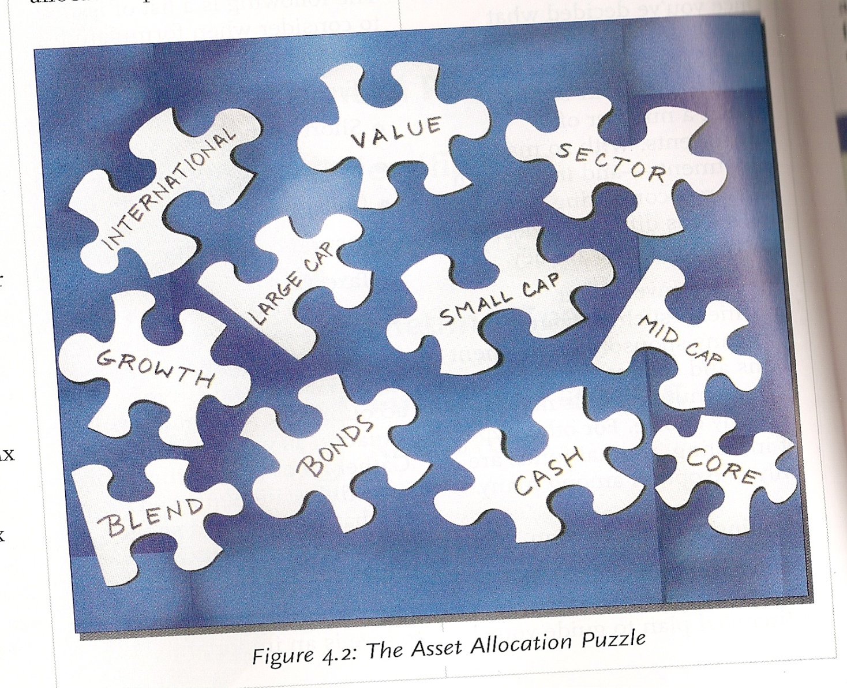
Diversification
Diversification works because stocks and bonds- and indeed different types of stocks and bonds- perform differently at different times. For example, when stocks perform well, often bonds do not. And even stocks are generally performing well, not every company joins the party. A good example is the bull market of the late 1990s. At that time, virtually any company that related to technology experienced incredible returns.

Slide 24
Portfolio Construction Assets Allocation
Asset allocation refers to the practice of dividing your assets among investing vehicles. Various assets allocation theories and practices suggest methods to divide a portfolio between different types of stock and bond funds. In constructing an asset allocation plan, consider all of your investments or your investments in a specific type of account.

Slide 25
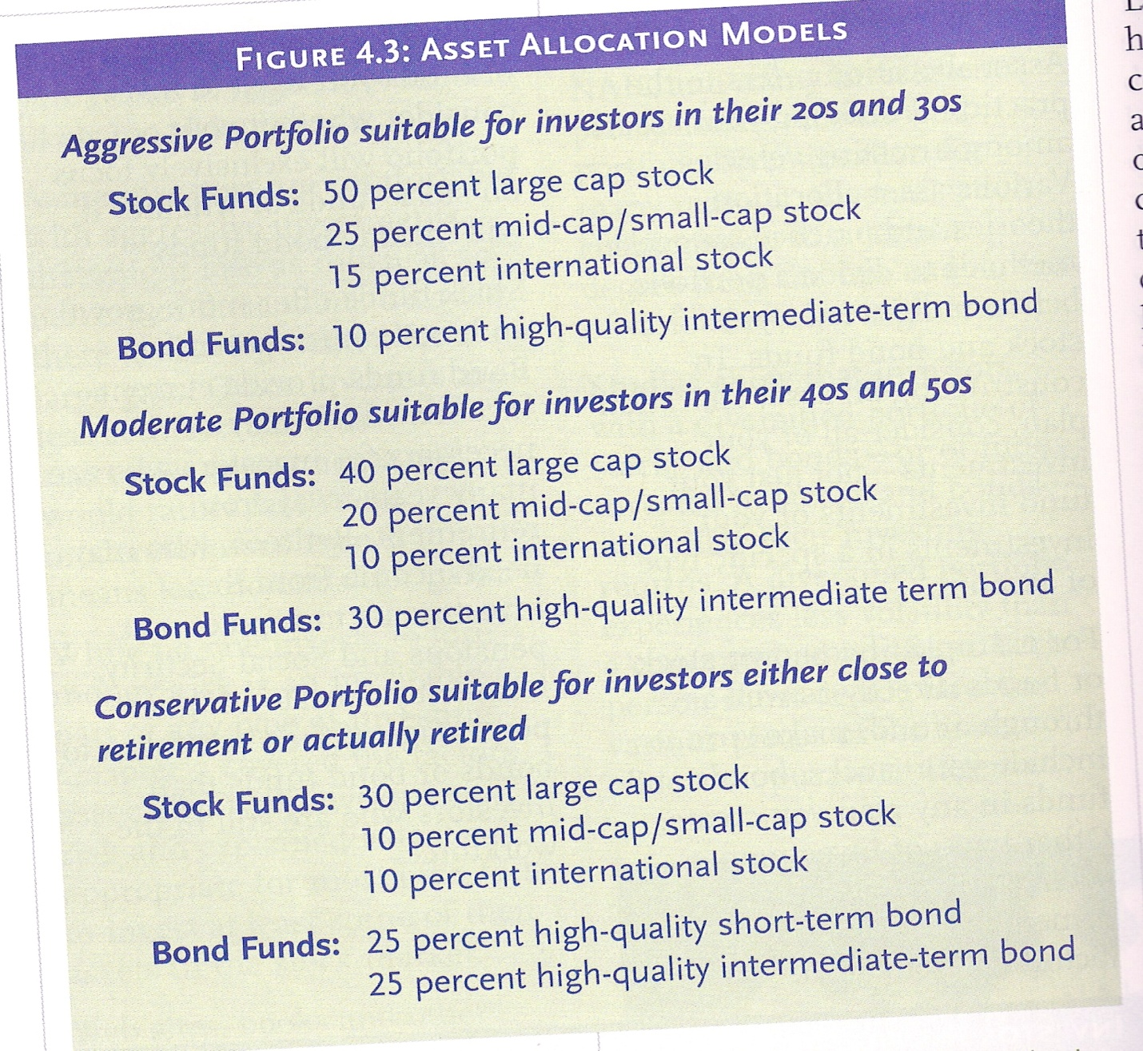
Example of assets allocation models

Slide 26
Assets Allocation for the chosen 14 ETFs
For a portfolio optimization as stated in the objective, the two competing goals of investment are (1) long-term growth of capital and (2) low risk.
A good portfolio grows steadily without wild fluctuations in value. The Markowitz model is an optimization model for balancing the return and risk of a portfolio. The decision variables are the amounts invested in each asset. The objective is to minimize the variance of the portfolio's total return, subject to the constraints that (1) the expected growth of the portfolio reaches at least some target level and (2) you do not invest more capital than you have.

Slide 27

Assets Allocation for the chosen 14 ETFs Theory and Formulation
Let x1, x2, …,x14 be the amount invested in each asset, B be the amount of capital you have, R be the random vector of asset returns over some period, and r be the expected value of R . Let G be the minimum growth you hope to obtain, and C be the covariance matrix of R. The objective function is , which can be equivalently denoted as
Using the 14 ETFs, we will allocate multiple portfolios based on daily, weekly, monthly returns and their expected growth.
Let β=$10,000, n=14, r=E(R)=expected of value of the rate of return, G is the desired growth in percentage and C is the covariance.

Slide 28
Daily Return Covariance Table
 | SPY | IJH | IJR | IYY | XLE | EWZ | EWJ | EWH | EEM | EZU | EFA | AGG | IAU | IYR
SPY | 2.14 | -0.20 | -0.16 | -0.21 | -0.46 | -0.28 | -0.21 | -0.21 | -0.15 | -0.22 | -0.23 | -0.07 | -0.19 | -0.18
IJH | 2.22 | 2.57 | 2.66 | 2.20 | 2.82 | 3.71 | 1.95 | 2.59 | 3.47 | 2.64 | 2.43 | -0.05 | 0.22 | 3.61
IJR | 2.28 | 2.66 | 2.97 | 2.28 | 2.77 | 3.69 | 1.98 | 2.65 | 3.50 | 2.67 | 2.45 | -0.10 | 0.15 | 3.87
IYY | 2.03 | 2.20 | 2.28 | 2.01 | 2.53 | 3.34 | 1.78 | 2.39 | 3.15 | 2.44 | 2.24 | -0.05 | 0.15 | 3.17
XLE | 2.63 | 2.82 | 2.77 | 2.53 | 4.96 | 5.13 | 2.44 | 3.21 | 4.46 | 3.30 | 3.08 | -0.03 | 0.81 | 3.46
EWZ | 3.45 | 3.71 | 3.69 | 3.34 | 5.13 | 8.32 | 3.36 | 4.53 | 6.51 | 4.47 | 4.18 | -0.01 | 0.93 | 4.73
EWJ | 1.88 | 1.95 | 1.98 | 1.78 | 2.44 | 3.36 | 2.59 | 2.51 | 3.25 | 2.47 | 2.45 | 0.02 | 0.34 | 2.63
EWH | 2.48 | 2.59 | 2.65 | 2.39 | 3.21 | 4.53 | 2.51 | 4.16 | 4.53 | 3.07 | 2.93 | -0.08 | 0.28 | 3.69
EEM | 3.26 | 3.47 | 3.50 | 3.15 | 4.46 | 6.51 | 3.25 | 4.53 | 6.27 | 4.20 | 3.93 | -0.08 | 0.64 | 4.74
EZU | 2.52 | 2.64 | 2.67 | 2.44 | 3.30 | 4.47 | 2.47 | 3.07 | 4.20 | 3.74 | 3.25 | -0.01 | 0.53 | 3.69
EFA | 2.34 | 2.43 | 2.45 | 2.24 | 3.08 | 4.18 | 2.45 | 2.93 | 3.93 | 3.25 | 3.02 | 0.00 | 0.47 | 3.34
AGG | -0.03 | -0.05 | -0.10 | -0.05 | -0.03 | -0.01 | 0.02 | -0.08 | -0.08 | -0.01 | 0.00 | 0.15 | 0.05 | -0.15
IAU | 0.13 | 0.22 | 0.15 | 0.15 | 0.81 | 0.93 | 0.34 | 0.28 | 0.64 | 0.53 | 0.47 | 0.05 | 1.89 | 0.09
IYR | 3.15 | 3.61 | 3.87 | 3.17 | 3.46 | 4.73 | 2.63 | 3.69 | 4.74 | 3.69 | 3.34 | -0.15 | 0.09 | 7.11

Slide 29
Assets Allocation Table from Daily Returns
 |  |  | Budget=β=$10,000
 |  |  |  |  | Growth%
 |  | 0.02 | 0.025 | 0.03 | 0.035 | 0.04 | 0.05 | 0.07 | 0.09
ETFs | r % |  |  |  | Allocations
SPY | 0.02 | $875.21 | $868.75 | $872.51 | $897.19 | $922.19 | $946.52 | $974.01 | $1,001.51
IJH | 0.04
IJR | 0.04 | $356.92 | $561.09 | $514.88 | $247.62
IYY | 0.02 | $401.43 | $104.83
XLE | 0.07
EWZ | 0.14 |  |  |  | $250.76 | $520.81 | $912.57 | $1,527.23 | $2,141.88
EWJ | 0.02
EWH | 0.06 |  | $38.88 | $227.15 | $175.88 | $91.08
EEM | 0.09
EZU | 0.03
EFA | 0.03
AGG | 0.02 | $7,968.42 | $7,894.69 | $7,233.79 | $6,864.52 | $6,509.98 | $5,419.60 | $2,974.00 | $528.41
IAU | 0.09 | $398.02 | $531.76 | $1,151.66 | $1,525.01 | $1,879.54 | $2,721.31 | $4,524.76 | $6,328.20
IYR | 0.05 |  |  |  | $39.02 | $76.41
 | Std(Pi) | 3313.813 | 3322.777 | 3502.013 | 3881.245 | 4366.850 | 5573.383 | 8523.635 | 11742.389
 | RR | 1.000 | 1.003 | 1.057 | 1.171 | 1.318 | 1.682 | 2.572 | 3.543

Slide 30
Thus, the minimum variance for portfolio1 that earns an expected return of at least .02% is x₁= $875.21, x₂ = 0, x₃= $356.92, x₄=$401.43, x₅ to x₁₁ got no allocation, x₁₂=$7968.42, x₁₃=$398.02 and x₁₄=0. Some assets get nothing because their covariance with the other assets is not sufficiently negative for it to bring any diversification benefits.

Slide 31
Assets Allocation from Weekly Returns Weekly Returns Covariance Table
 | SPY | IJH | IJR | IYY | XLE | EWZ | EWJ | EWH | EEM | EZU | EFA | AGG | IAU | IYR
SPY | 8.40 | 9.24 | 9.51 | 8.12 | 9.67 | 13.11 | 6.44 | 7.64 | 10.82 | 9.50 | 8.57 | 0.64 | 0.06 | 10.76
IJH | 9.24 | 11.23 | 11.57 | 9.18 | 11.12 | 15.32 | 6.99 | 8.44 | 12.61 | 10.68 | 9.53 | 0.43 | 0.71 | 13.16
IJR | 9.51 | 11.57 | 12.61 | 9.47 | 11.02 | 15.11 | 7.05 | 8.71 | 12.98 | 10.89 | 9.66 | 0.29 | 0.52 | 14.16
IYY | 8.12 | 9.18 | 9.47 | 7.99 | 9.37 | 12.71 | 6.14 | 7.33 | 10.54 | 9.22 | 8.25 | 0.48 | 0.16 | 10.81
XLE | 9.67 | 11.12 | 11.02 | 9.37 | 17.83 | 19.37 | 8.35 | 9.21 | 14.62 | 12.14 | 11.11 | 0.78 | 3.63 | 10.72
EWZ | 13.11 | 15.32 | 15.11 | 12.71 | 19.37 | 32.06 | 11.51 | 14.36 | 22.64 | 17.18 | 15.65 | 0.82 | 4.04 | 15.96
EWJ | 6.44 | 6.99 | 7.05 | 6.14 | 8.35 | 11.51 | 8.78 | 7.10 | 9.83 | 8.37 | 8.20 | 0.74 | 0.91 | 7.37
EWH | 7.64 | 8.44 | 8.71 | 7.33 | 9.21 | 14.36 | 7.10 | 11.82 | 12.25 | 9.72 | 8.97 | 0.46 | 1.19 | 10.01
EEM | 10.82 | 12.61 | 12.98 | 10.54 | 14.62 | 22.64 | 9.83 | 12.25 | 19.31 | 14.35 | 12.95 | 0.47 | 2.71 | 14.27
EZU | 9.50 | 10.68 | 10.89 | 9.22 | 12.14 | 17.18 | 8.37 | 9.72 | 14.35 | 13.95 | 11.89 | 0.66 | 1.95 | 12.14
EFA | 8.57 | 9.53 | 9.66 | 8.25 | 11.11 | 15.65 | 8.20 | 8.97 | 12.95 | 11.89 | 10.69 | 0.73 | 1.76 | 10.65
AGG | 0.64 | 0.43 | 0.29 | 0.48 | 0.78 | 0.82 | 0.74 | 0.46 | 0.47 | 0.66 | 0.73 | 0.80 | -0.15 | 0.09
IAU | 0.06 | 0.71 | 0.52 | 0.16 | 3.63 | 4.04 | 0.91 | 1.19 | 2.71 | 1.95 | 1.76 | -0.15 | 8.30 | 0.46
IYR | 10.76 | 13.16 | 14.16 | 10.81 | 10.72 | 15.96 | 7.37 | 10.01 | 14.27 | 12.14 | 10.65 | 0.09 | 0.46 | 22.04

Slide 32
Assets Allocation Table for Weekly Returns
 |  | Budget=β=$10,000
 |  |  |  |  | Growth%
 |  | 0.1 | 0.15 | 0.2 | 0.25 | 0.3 | 0.4 | 0.5 | 0.6
 |  |  |  |  | Allocation on i=1 to 8 Porfolios
ETF's | r % | 1 | 2 | 3 | 4 | 5 | 6 | 7 | 8
SPY | 0.1
IJH | 0.18
IJR | 0.16 | $60.92
IYY | 0.1
XLE | 0.3
EWZ | 0.62 |  |  | $414.62 | $891.84 | $1,285.40 | $2,072.40 | $4,000.00 | $9,000.00
EWJ | 0.07
EWH | 0.27 |  | $187.43 | $205.43
EEM | 0.36
EZU | 0.1
EFA | 0.12
AGG | 0.09 | $8,749.15 | $7,942.39 | $6,824.57 | $5,692.03 | $4,415.40 | $1,862.10
IAU | 0.42 | $972.45 | $1,666.59 | $2,555.37 | $3,416.13 | $4,299.30 | $6,065.60 | $6,000.00 | $1,000.00
IYR | 0.17 | $217.48 | $203.59
 | Std(Pi) | 8301.018 | 8623.0264 | 10508.252 | 13243.43 | 16439.298 | 23459.429 | 31712.458 | 34641.016
 | RR | 1.000 | 1.039 | 1.266 | 1.595 | 1.980 | 2.826 | 3.820 | 4.173

Slide 33
Similarly, the minimum variance for weekly portfolio1 that earns an expected return of at least .01% is x₃= $60.92, x₁₂=$ 8749.15, x₁₃= $972.45, x₁₄=217.48; the other x_{i} got no allocation. About 71% of the assets get nothing because their covariance with the other assets is not sufficiently negative for them to bring any diversification benefits.

Slide 34
Assets Allocation from Monthly Returns Monthly Returns Covariance Table
Monthly | SPY | IJH | IJR | IYY | XLE | EWZ | EWJ | EWH | EEM | EZU | EFA | AGG | IAU | IYR
SPY | 22.60 | 25.60 | 26.52 | 23.13 | 22.96 | 35.92 | 18.18 | 24.66 | 32.08 | 31.98 | 26.44 | 0.85 | 1.56 | 32.50
IJH | 25.60 | 32.07 | 33.25 | 26.70 | 27.68 | 42.91 | 21.45 | 27.77 | 37.51 | 35.41 | 29.54 | 0.81 | 2.09 | 39.90
IJR | 26.52 | 33.25 | 36.96 | 27.75 | 26.73 | 40.15 | 22.03 | 26.92 | 37.58 | 36.44 | 30.09 | 0.54 | -0.30 | 43.98
IYY | 23.13 | 26.70 | 27.75 | 23.82 | 23.62 | 37.16 | 18.79 | 25.34 | 33.08 | 32.74 | 27.10 | 0.86 | 1.53 | 33.94
XLE | 22.96 | 27.68 | 26.73 | 23.62 | 50.74 | 57.67 | 20.71 | 30.21 | 42.07 | 34.08 | 29.75 | -0.53 | 10.65 | 25.66
EWZ | 35.92 | 42.91 | 40.15 | 37.16 | 57.67 | 106.72 | 34.38 | 57.49 | 74.39 | 57.82 | 49.85 | 1.31 | 20.08 | 45.10
EWJ | 18.18 | 21.45 | 22.03 | 18.79 | 20.71 | 34.38 | 25.74 | 22.02 | 31.08 | 30.19 | 27.00 | 1.85 | 4.87 | 27.72
EWH | 24.66 | 27.77 | 26.92 | 25.34 | 30.21 | 57.49 | 22.02 | 46.16 | 47.09 | 39.72 | 33.97 | 1.91 | 10.14 | 33.21
EEM | 32.08 | 37.51 | 37.58 | 33.08 | 42.07 | 74.39 | 31.08 | 47.09 | 62.64 | 52.16 | 44.13 | 1.97 | 12.35 | 44.82
EZU | 31.98 | 35.41 | 36.44 | 32.74 | 34.08 | 57.82 | 30.19 | 39.72 | 52.16 | 55.60 | 44.57 | 2.74 | 5.72 | 47.02
EFA | 26.44 | 29.54 | 30.09 | 27.10 | 29.75 | 49.85 | 27.00 | 33.97 | 44.13 | 44.57 | 37.21 | 2.04 | 5.90 | 38.38
AGG | 0.85 | 0.81 | 0.54 | 0.86 | -0.53 | 1.31 | 1.85 | 1.91 | 1.97 | 2.74 | 2.04 | 1.64 | 2.21 | 2.76
IAU | 1.56 | 2.09 | -0.30 | 1.53 | 10.65 | 20.08 | 4.87 | 10.14 | 12.35 | 5.72 | 5.90 | 2.21 | 28.52 | 2.95
IYR | 32.50 | 39.90 | 43.98 | 33.94 | 25.66 | 45.10 | 27.72 | 33.21 | 44.82 | 47.02 | 38.38 | 2.76 | 2.95 | 71.46

Slide 35
Assets Allocation Table for Monthly Returns
 |  |  | Budget=10000
 |  |  |  |  |  | Growth%
 |  | 0.4 | 0.5 | 0.6 | 0.7 | 0.8 | 0.9 | 1 | 1.5 | 1.7
 |  |  |  |  |  | Portfolios
ETF's | r % | 1 | 2 | 3 | 4 | 5 | 6 | 7 | 8 | 9
SPY | 0.37
IJH | 0.73
IJR | 0.63
IYY | 0.42
XLE | 1.2 | $406.06 | $580.68 | $383.33 | $164.15
EWZ | 2.57 |  |  | $246.67 | $512.90 | $752.64 | $913.36 | $1,074.10 | $1,877.70 | $2,199.10
EWJ | 0.25
EWH | 1.14
EEM | 1.45
EZU | 0.43
EFA | 0.52
AGG | 0.4 | $9,593.94 | $9,010.57 | $8,485.99 | $7,982.73 | $7,440.67 | $6,782.82 | $6,125.00 | $2,835.70 | $1,520.00
IAU | 1.71 |  | $408.74 | $884.01 | $1,340.21 | $1,806.69 | $2,303.82 | $2,801.00 | $5,286.60 | $6,280.90
IYR | 0.69
 | Std(Pi) | 12457.47 | 13069.59 | 14710.93 | 16846.47 | 19314.29 | 22037.63 | 24945.83 | 40809.35 | 47441.07
 | RR | 1.000 | 1.049 | 1.181 | 1.352 | 1.550 | 1.769 | 2.002 | 3.276 | 3.808

Slide 36
For this portfolio, the minimum variance from Monthly portfolio4 that earns an expected return of at least .06% is x₅= $383, x₆$246.67, x₁₂= $8,485.99, x₁₃=$884.01. About 85% of the assets got into the Bond (AGG). The other x_{i} got no allocation because their covariance with the other assets is not sufficiently negative for them to bring any diversification benefits.

Slide 37
Conclusion
The data used during this project contained ETFs that are mostly correlated with exception of few ETFs such as Bond (AGG), Gold(IAU) and SPY(SPDR) that show low or no correlations with the others. Therefore, the assets allocation were affected by those factors. Most assets got no allocation. In addition, the expected growth desired was affected by the mean value of the rate of returns.
In order to increase growth and get more allocations, a portfolio that is similar to the following is good.

Slide 38
Recommended Pairs
MRK | + 0.0 | YHOO
MRK | + 0.03 | JPM
JPM | + 0.08 | F
T | + 0.14 | YHOO
M | + 0.22 | CRM
JPM | + 0.25 | T
T | + 0.25 | GOOG
Note that as we increase growth/profit, we also increase the risk of the portfolio.

Slide 39
Reference
Wikipedia
Better Investing
Yahoo Finance

Slide 40
Thank you

Slide 41
Questions

